Slide 1
Who is this Gideon and how will he help me?
or how to use the database to
Solve the Microbiology Unknown

Slide 2
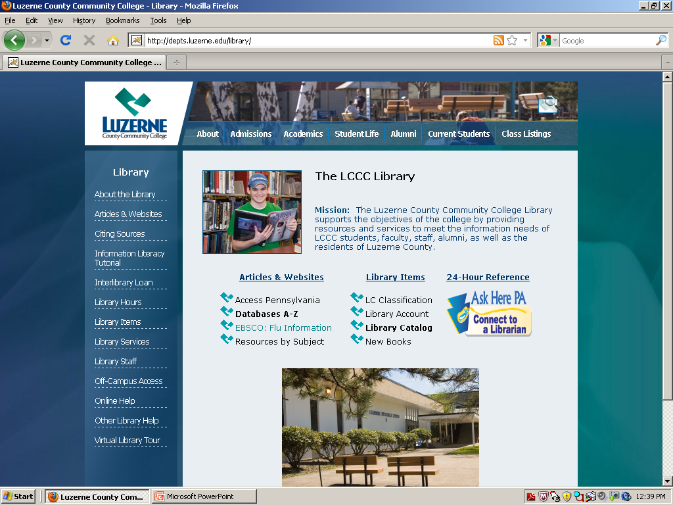
How to Begin
Access the library webpage either in the library are through the student Intranet
Locate and click on the database A-Z

Slide 3
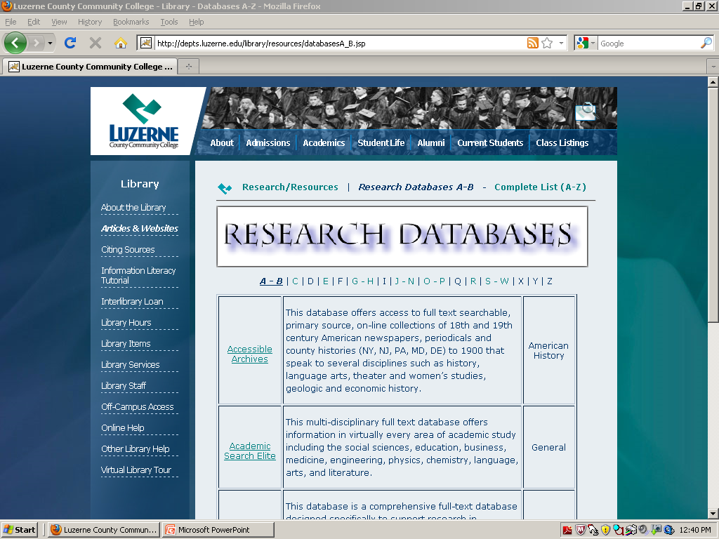
Find the Gideon link
Click on the G-H.
When that is loaded then scroll down to
Gideon.
The name and link will
appear here.

Slide 4
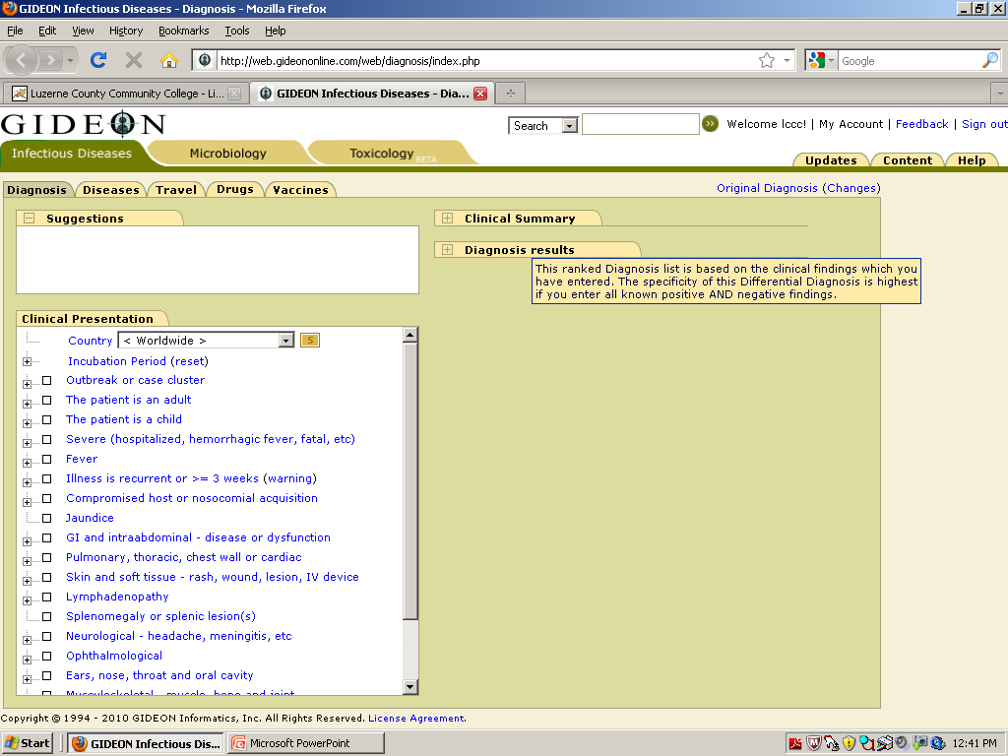
Success! You have made it to the site. Now what?
Click on the Middle tab labeled “Microbiology”

Slide 5
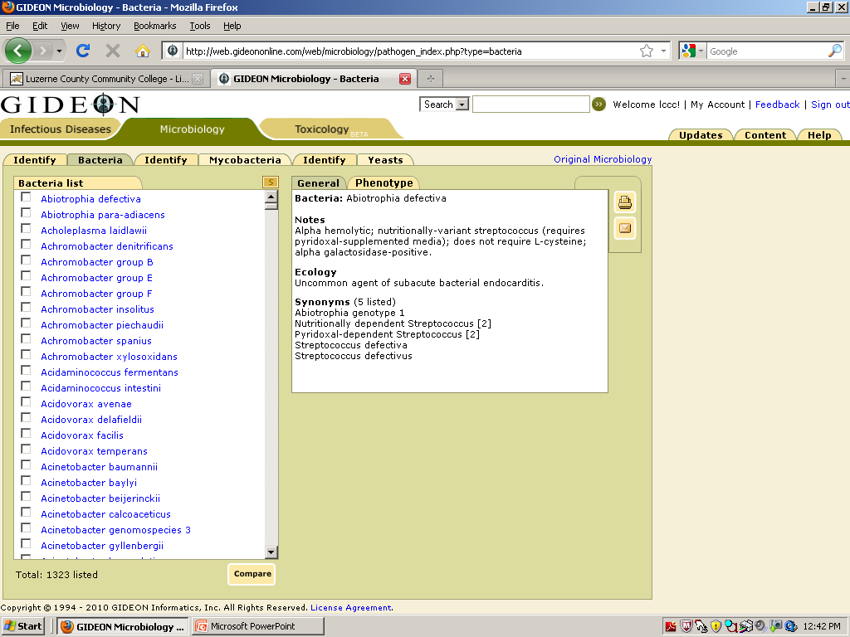
Anatomy of the site.
Search engine to find the microbe quickly. This is useful since bacteria names change often.
List of all the microbes on the site.
Characteristics of the bacteria
Method of printing the page
Method of comparing more than one bacteria

Slide 6
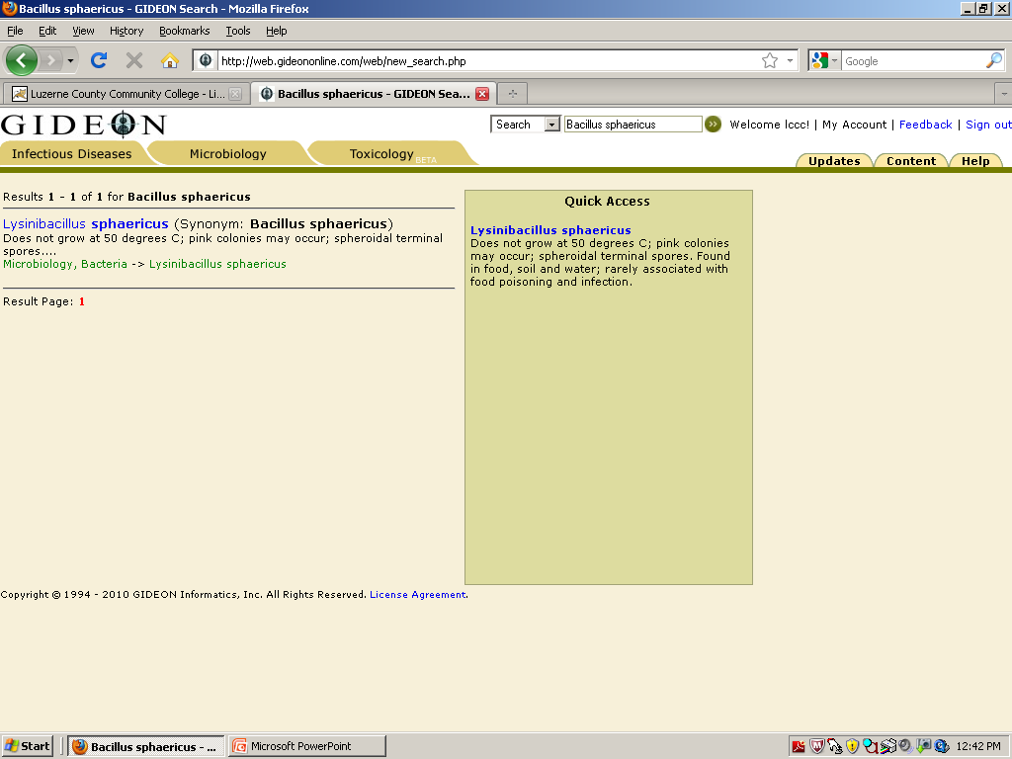
Checking the Name of the Bacterium
Microbe names change frequently as we learn more and more about them. This will eventually make for better taxonomy but annoys us now.
Always check a microbe’s name. Here we typed in Bacillus sphaericus and discovered that it is now called Lysinibacillus sphaericus. We would never have guessed if we just scrolled through the microbes.

Slide 7
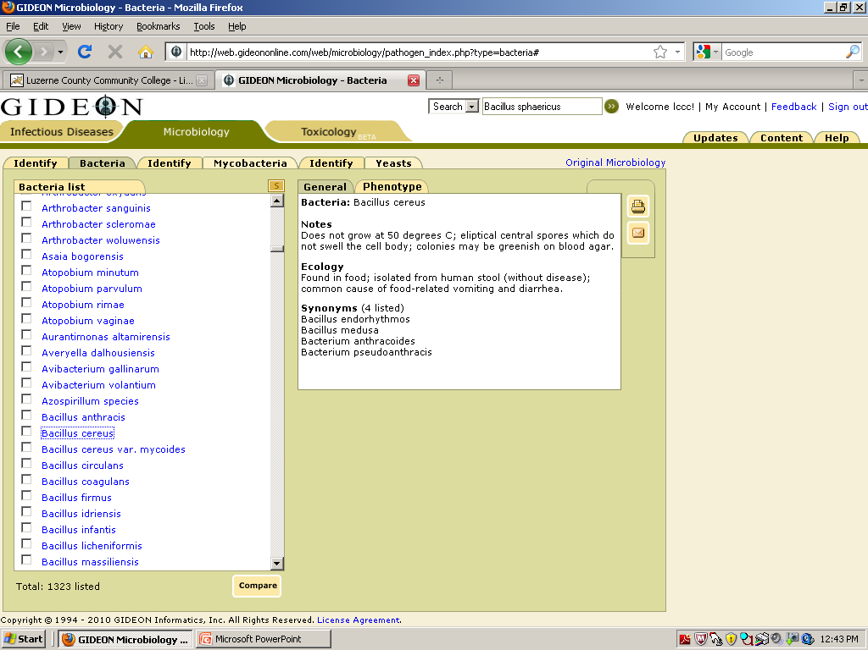
General information
We want information on Bacillus cereus.
We checked the name of the microbe and have found it in the list.
Click on the name in the list (not the box) and the general features appear to the right.

Slide 8
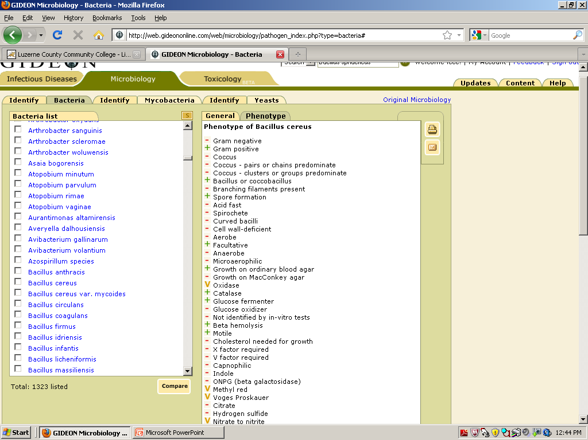
More information
Clicking on the phenotype tab gives information on the metabolic tests.
Remember
  + is a positive result
  is a negative result
  V means the results are variable due to strains
  D means that the results are demonstratable but not a 100% of the time

Slide 9
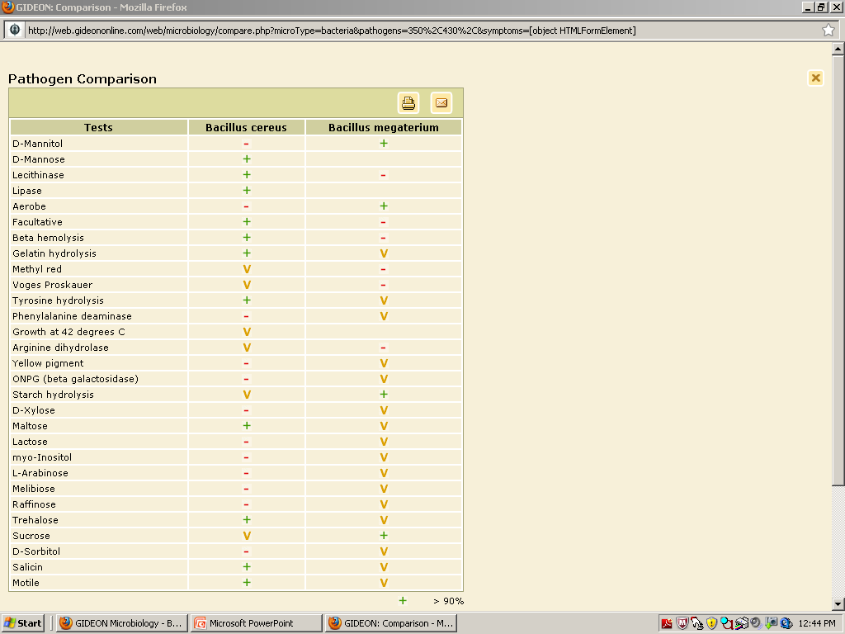
Finding out what tests to do when you have two or three microbes left.
Click on the box in front of the name of the two or three microbes from the list.
Click on compare tab at the bottom of the page.
Voila! A list of how the two microbes are different.

